Slide 1
Robots.txt: There's gold in them thar files
Justin Rogosky
06-19-2015

Slide 2
Agenda
Presentation – Robots.txt
History
Usages
Analysis
Questions

Slide 3
304 Geeks
Group of people with an interest in technology with a single goal of spreading information about the safe, secure, and beneficial uses of technology.
Secure WV (formerly Hack3rCon) occuring in early Nov in Charleston
Notes:
Shameless Plug

Slide 4
And now our feature Presentation...

Slide 5
History
Officially called the Robots Exclusion Standard
Not an offical Standard
Completely voluntary
Invented in 1994...
Show of hands who is older than robots.txt
Created by Martijn Koster to after being goaded into developing a method of preventing DOSing
Notes:
Taunted into making it
Wasn't meant as protection, butthe internet was different then and not just less porn

Slide 6
Purpose
The initial purpose was to prevent a webcrawler from DOSing a website
Yes, in the before time websites could be crashed by 1 other computer
It still wasn't hacking
The idea is a text file that the webcrawler, called a robot, would look at for the rules of indexing the site
Human readable format, but not meant to be read by humans
Located at http(s)://www.example.com/robots.txt
Not the only way to control indexing by robots
You can add tags to the code of your webpage
But they need to be crawling the site already
Notes:
Prevent DOS
All robots were good robots
Other methods developed later
Standard location
Very easy to read, but meant for machines

Slide 7
Purpose cont.
Allows the website to “control“ what gets searched / indexed by a search engine
Want to drive traffic to your site
Entire industries revolve arond search engine optimization
Many admins use this to “hide“ locations from search engines
Admin folders
User folder
Other sensitive areas
Anyone see an issue with this?
Notes:
Traffic means $$$
Want to make sure traffic coming to the site is your market
Mistakenly used as a security control

Slide 8
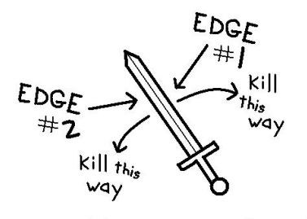
Purpose cont.
Double Edge Sword
Lets search engines and webcrawlers index your site
Traffic = $$$
Allowing only what you want to be crawled is crawled
Many sites list sensitive sections of the website
Mistaken belief that if it is "hidden", it is not accessible
Notes:
Double edge sword
Balance the need to limit what is indexed and what is sensitive

Slide 9
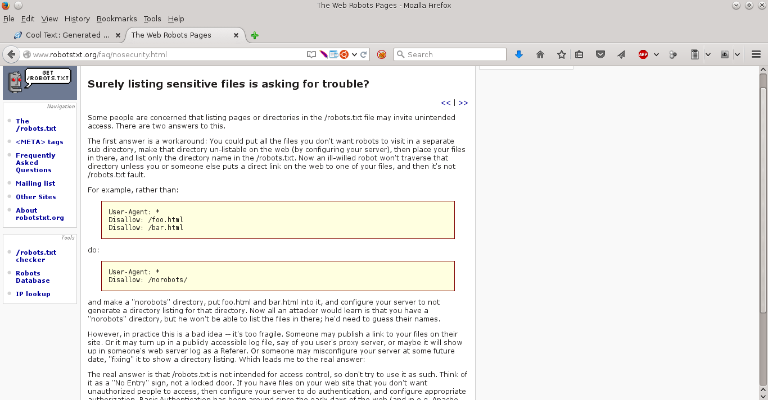
Purpose cont
Notes:
Robotstxt.org has a listing about why this is bad
And then proceeds to give pretty bad advice

Slide 10
Purpose cont
Robotstxt.org site captures the issue very succinctly
Notes:
Bad advice / good advice

Slide 11
Anatomy of Robots.txt
No defined standard, more of a gentlemens agreement
Standard extensions – recognized as allowed and expected to be present
Comments – extra bits of VERY useful information that few people add to code – not just robots.txt
User-agent – The identification a browser or webcrawler uses in this case (rant to come)
Disallow – explicitly forbidding a webcrawler from indexing / searching a location
Notes:
Spiders need to track what is in the robots.txt file and not crawl the listings even if directly linked
Comments
User agents
Disallow

Slide 12
Anatomy cont
Non-Standard Extensions – not formally recognized as a standard, but widely accepted
* - the asterisk is a non-standard convention, but it is widely accepted
Crawl-delay – tells a webcrawler to index at a certain rate
Host – allows domains to specify their preffered domain if crawling a mirror
Allow – explicit permission to search / crawl this location
Sitemap – listing of the sitemap, might make the crawling easier, but it is an explicit way of listing the "allowed" content of your site
Notes:
* is not standard, but is the most widely used
Crawl delay is a nice idea, but strange
Allow
Sitemap one stop shopping for al your site crawling needs

Slide 13
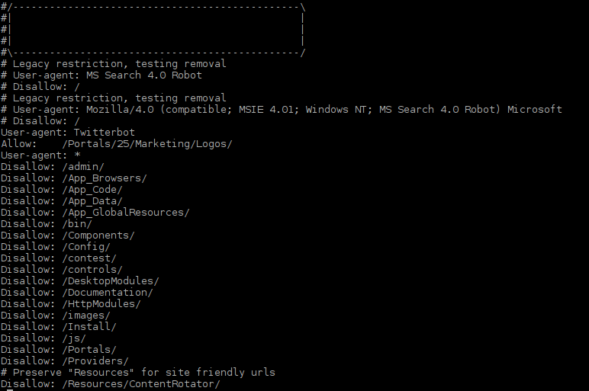
Anatomy cont.

Slide 14
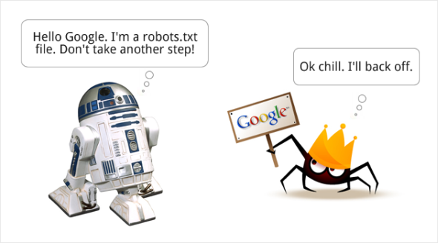
The Process
Notes:
Only applicable to good robots

Slide 15
Thats nice, Justin but who cares
This isn't a brand new attack vector, everyone has been doing this for years...
What kind I get out of this talk?
2 things hopefully
Examples of information that can be extracted from a single robots.txt
Listing of the most popular hidden directories

Slide 16
Information Gathering
In addition to all of the "prohibited" files and folders, robots.txt is full of a lot of useful information
Not useful for statistics, but very useful for targetted engagements
Notes:
Individual files very useful for specific targets when you are looking

Slide 17
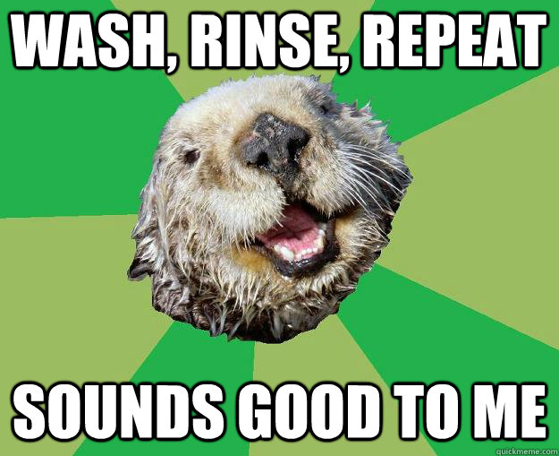
Fun Finds
The following slides are examples of fun finds
Dig through the files using grep
Look for weird things
Laugh a little
Take screenshot
Put in presentation

Slide 18
Fun Finds
Content Management Systems / Site Builders
Notes:
Content Management systems

Slide 19
Fun Finds cont
Infrastructure
Notes:
Infrastructure

Slide 20
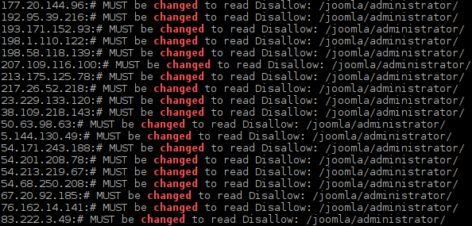
Fun Finds cont
Notes:
Joomla

Slide 21
Fun Finds cont
Name / Inititals
Notes:
Names .initials

Slide 22
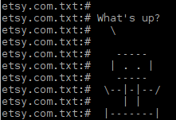
Fun Finds cont
Asimov References
This guy
Notes:
Asimov references

Slide 23
Fun Finds cont
Bitching / misunderstanding
Notes:
Complaints and bitching

Slide 24
Fun Finds cont
My Personal Favorite...recruitment
Notes:
Etsy
I emailed and it bounced back

Slide 25
Statistics Project
Theory: Similar sites will have similar needs to hide locations on websites
Method: Pull specific and randoms robots.txt files and analyze the directories listed
Wrote a script that scans for open port 80 on random IPs, grepped open ones, and wget pulled robots.txt
Repeated until I had > 1500 usable files
Pulled robots.txt files from representative industries / sectors
Notes:
Pull files
Remove crap
Analyze

Slide 26
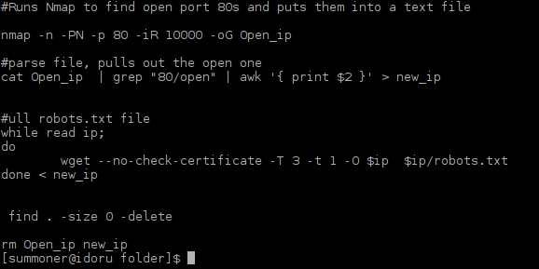
Script
Notes:
Nmap random ip address
Port 80 open
Was going to use the scans.io stuff, but it was a lot of data to pull
Wget
Awk / sed / sort / uniq
Libreoffice

Slide 27
Script cont.
Ran numerous times to get what I felt was a representative sample set
Ran into issues
A lot of blank files were pulled, because the website returned a 200, but didn't have a robots.txt file
A lot of 404s returned
A lot of sites returned their normal default page, because that is their default behavior
Original script used 1000 random Ips, changed to 10,000 after not going fast enough.
Still pretty slim pickings for robots.txt files, not as popular as they used to be
Also, wget lists the original dates, but got changed because I'm an idiot. Most of the dates were quite old.
Notes:
Started at 1000 sites, jumped to 10000
Still pull only abnout 2000 viable ones

Slide 28
Issues with Pulling files
Not everyone has a webserver running
Nmap filtered a lot of this out
Those running webservers didn't always return something useful
Not everyone has a robots.txt
Seems to be becoming more obsolete
For Example...
Notes:
System didn't alway return useful stuff

Slide 29
This guy
Notes:
This was someones AWS instance and all it did was serve up this picture. To whomever owns this site, i owe you a couple pennies...

Slide 30
Or this site
Notes:
This was on a 3g router. The main site was a login page and this is their 404 but rreturned as a 200

Slide 31
Scripts cont
Wrote a python scripts to pull all of the user agents, and assign their particular disallows
Problems
Each User-Agent string can be stacked on other User-Agent strings and the disallows apply to both of them
Some site developers went crazy with the User-Agents and Disallows
Limitations
Doesn't pull Allows or sitemaps
Doesn't look at comments
Notes:
Wrote a script to parse the data
Multiple useragents back to back apply to multuple disallows

Slide 32
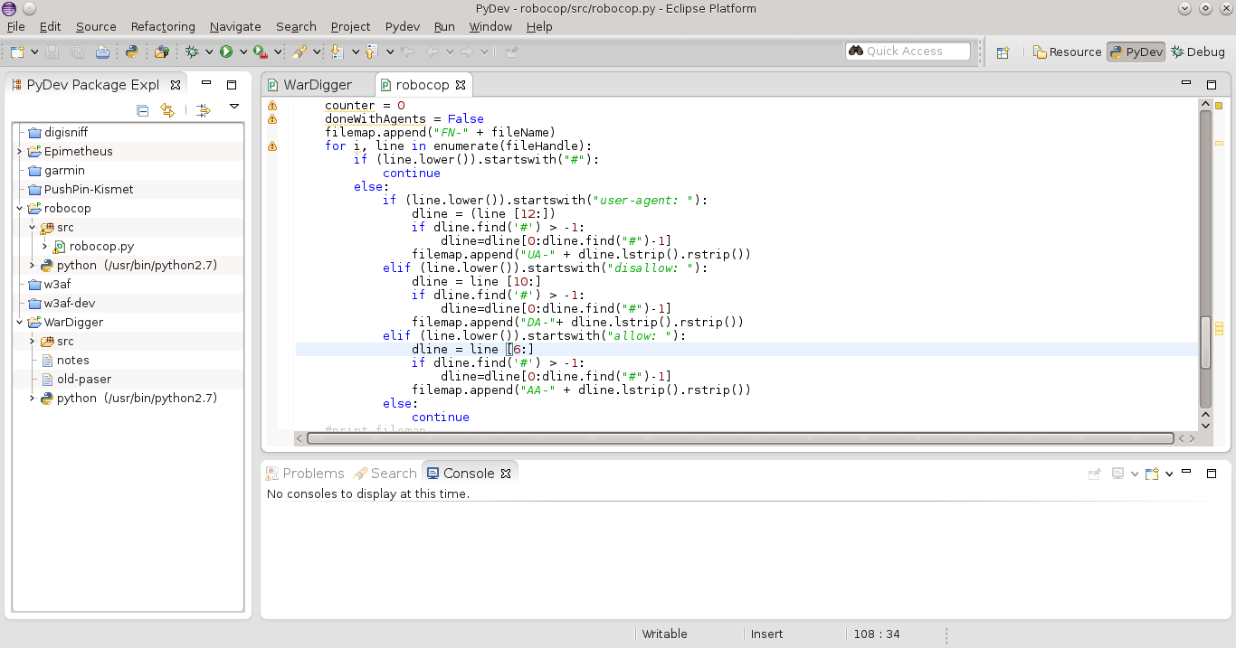
Script cont

Slide 33
Results cont.
User-Agents
Most popular listed User-Agent String was "*"
Followed by GoogleBot
Identified nearly 1000 unique UserAgents
Many versioning issues
A lot of spiders out there
These are VERY hard to parse
If you need to spider a website, for security purposes, you should alter your User-Agent string to see how the site responds using differnet crawlers
Can set the User-Agent on your browser (well, some browsers)
Results will vary
A popular tech site that provided answers to questions USED to (not sure if it still does) allow google full access to its site, but others User-Agent strings were limited
Notes:
User agents SUCK

Slide 34
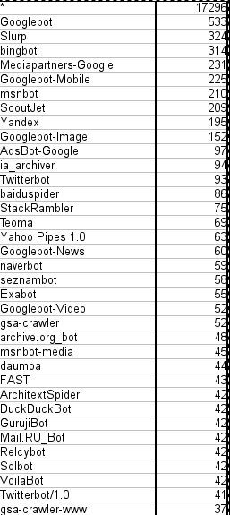
Results cont
Notes:
Pic of user agnets

Slide 35
Results cont
Disallow was the main point of the project
Surprised by the variety
Root (/) was the most popular obviously
Case Sensitive look at the disallows
wp-admin was most popular
Reflect popularity of wordpress as a sitebuilder
admin was next most popular
Makes sense
Case Insensitive look
Analytics followed by Departments

Slide 36
Results cont
3163 | /
265 | ANALYTICS
224 | DEPARTMENTS
218 | SHOPPING
212 | MAPS
184 | IMAGES
165 | ACCOUNTS
159 | CSE
159 | PATENTS
159 | SQUARED

Slide 37
Results cont.
3097 | /
146 | /wp-admin/
113 | /admin/
101 | /includes/
100 | /images/
96 | /modules/
89 | /gallery/
79 | /search/
73 | /cache/
70 | /wp-includes/

Slide 38
Results cont
Separated by types
Used the following types
Social Network
News
Commercial
Search Engine
Banks
Government
Porn
College
Entertainment
Didn't approach this is scientifically as possible
Randomly chose site and numbers
Didn't even out the amount of sites used

Slide 39
Results cont
Social Networks had the most to "hide"
News sites weren't that far behind
A lot of them had specific instructions for the search engines
Surprised they took time to split them out
Next slide shows disallows
1582 | socialnetwork
1578 | news
1301 | commercial
815 | searchengine
785 | bank
388 | government
171 | porn
164 | college
139 | entertainment

Slide 40
Results cont
Some differences were noted between the selected "types" and the ones from the random nmap sweep
Not really significant
May look into this more
There was more commonality than difference
May change as I expand the types and get better at parsing

Slide 41
Next Steps
Next steps
More analysis
Distribute list for dirbuster and other tools
????
Profit
Need to pull the directories from the listings
Pulled the list, but need to refine

Slide 42
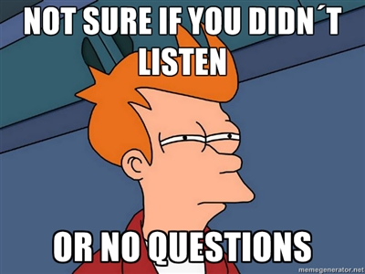
Questions

