Slide 1
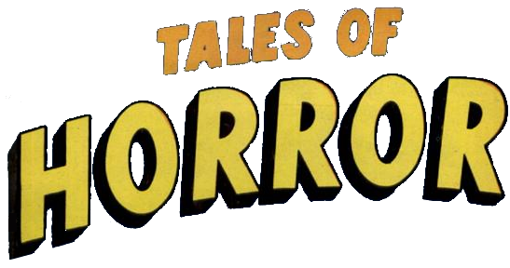
(and lots of how-to information about Security Breaches)
Presented to BSides by:
Dr. Charles Wood, CISSP
Duquesne University

Slide 2
Compliance that Drives Information Systems Security
Government
Health Insurance Portability and Accountability Act (HIPAA)
Sarbanes-Oxley
Industry
Credit cards and PCI

Slide 3
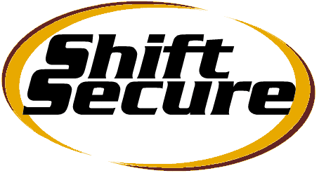
About Me…
Who I am not
I do not practice law, and this is not legal advice(!)
Seek legal advice from a lawyer
I do not audit (that much, anyway)
You probably need a CISA, not a CISSP, for auditing
I’ll admit, sometimes, the line is a little blurry between securing (which I do) and auditing (which I don’t do – that much).
I do not accredit
You need to have your systems accredited (usually internally by management)
You can train someone to help with this as well!
I do not certify
You need to have your systems certified by an recognized (external?) source
Who I am
Professor teaching
Information Security
Risk Management
IT Infrastructure
Software Development
Currently at Duquesne University (4 years)
Notre Dame (9 years)
University of Minnesota (4 years)
IT Consultant (over 25 years)
Degrees and certifications
CISSP
Probably the premier security certification
Ph.D. in Information Systems
MBA
Computer Science B.S.
Finance B.S.
And the CEO of ShiftSecure. (REALLY wish I had something to sell you!)

Slide 4
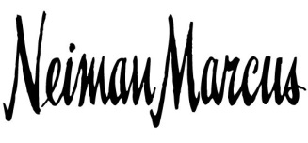
Credit card Breach Announcements January 2014
Target
Went from 40 million cards hacked to 70 million on 1/13 to 130 million today
If you shopped from late November to early December, be careful!
May have been storing 3-digit CVV codes. (Bad!)
How else do you steal a credit card?
Attack used malware called a “RAM Scraper” called POSRAM:
Uploads used but not cleared memory to the hacker
Infects POS systems
More sophisticated than seen before
Waited a month before first hearing about it and telling customers
Waited two weeks before conclusive proof existed and telling customers
Ongoing Investigation
Not fixed yet
Answers could take weeks
Investigator hints at a RAM Scraper, like Target
3 other undisclosed breaches
(hints of Eastern European retailers, which makes sense)

Slide 5
Credit card Breach Announcements 1/13/2014
Target and Neiman Marcus
A massive increase in bad card availability – 10x - 20x, on December 11.
2 million bad credit cards were dumped into the market on January 4.
Congress may get involved, on top of Visa involvement. Senate banking committee is examining this issue in the coming weeks.
InfoWeek reports that investigators say that at least three other as-yet-unnamed retailers were successfully breached at the end of 2013 by the same gang!!!
Strong overlap in time between the two breaches
Attacks were preceded by a series of smaller attacks that began a few months before the post-Thanksgiving shopping rush.
Timing may suggest that the attacks occurred where the stores were unwilling to get the bad press by immediately notifying customers. (Christmas rush.)
Want more 2014 breaches? Check out Verizon’s report: http://www.verizonenterprise.com/DBIR/2014/

Slide 6
SIDEBAR: Who is Brian Krebs?
Security blogger
Target only acknowledged its 2013 attack after Krebs reported the breach.
Neiman Marcus disclosed the 2013-2014 breach nine days after an inquiry from Krebs
OK, he’s Superman, for now. Here’s his link: http://krebsonsecurity.com/

Slide 7
Get the max for the minimum…
The (previous) largest Visa hack ever!
$9.75 million to 41 states. (Ouch!)
Ignored evidence for years!
Get this! PCI DSS
PCI DSS decided they weren’t complaint
After they certified by PCI DSS
And then fined them into oblivion!
(Get the max for the minimum, am I right?)

Slide 8
Target, Neiman, and TJMaxx were PCI DSS Compliant! (at one time)
The Payment Card Industry (PCI) has developed a Data Security Standard (DSS)
Considered Ultra-Secure
No one has ever hacked into a PCI DSS compliant company before!
BUT TJ Maxx / TJX was considered compliant, but had their compliancy retroactively revoked after a hack in 2007.
PCI claimed that they misrepresented their DSS compliance
This may happen to Target and Neiman with the CVV problem.
If you are hacked, you automatically are no longer considered PCI compliant until you fix what was wrong
Results in large, large, LARGE fines and possible refusal to accept credit card transactions!

Slide 9
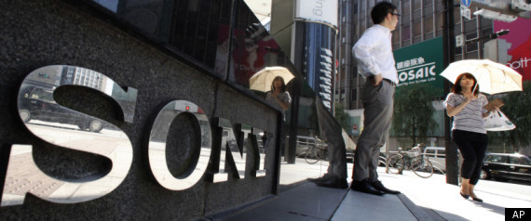
Injection attack at
Anonymous and LulzSec (group out of Arizona) hacked into Sony in 2011
Shut down business for a month
With … an SQL Injection attack … I mean, seriously, Sony … an SQL injection!
Ludicrously bad. Sony didn’t even know what was stolen for months!
Sony said the breach ultimately cost the company more than $600,000.
(Yeah, right. $600,000.)

Slide 10
PCI DSS – 12 Requirements
Use and maintain firewalls
Reset vendor password defaults
Protect cardholder data at rest (!)
Encrypt transmitted cardholder data
Use & update antivirus software
Systems and Applications must be developed with security in mind (!)
Cardholder data only available by “need to know”
Access controls with unique user ID
Physical access to data must be restricted
Network and data access must be tracked
Security systems must be regularly tested (!)
Policies in place that address information security (!)
Available at https://www.pcisecuritystandards.org/documents/PCI_DSS_v3.pdf
3.0 update available since November 2013

Slide 11
Potential PCI DSS cost of a security breach
Fines of $500,000 per incident for being PCI non-compliant
Fines of $50,000 per day for non-compliance with published standards
Can be retroactive if misrepresentation / fraud exists
Liability for all fraud losses incurred from compromised account numbers
Liability for the cost of re-issuing cards associated with the compromise
Suspension of merchant accounts
Increased audit requirements from PCI
Potential for enterprise-wide shut down of credit card activity by the merchant bank (This is bad … very bad!)
Cost of printing and postage for customer notification mailing
Cost of staff time (payroll) during security recovery
Cost of lost business during register or store closures and processing time
Decreased sales due to marred public image and loss of customer confidence

Slide 12
What PCI data can be stored…
Encrypted (!) Cardholder Data
Sensitive Data
Can store in database
Consists of:
Primary Account Number (PAN)
Cardholder Name
Expiration Date
Service Code (code that designates where the card is used (and for what) changes on the contactless interface)
Cannot store in database (unless there is a business justification)
Consists of:
Full track data (data on the magnetic strip or on a chip)
CAV2/CVC2/CVV2/CID (that three digit number on the back)
PINs (or PIN blocks)

Slide 13
OK, so PCI DSS can be hacked?...
PIN and Chip
Dissent from PCI DSS
Also known as EMV
Stands for Europay, MasterCard, and Visa
Refers to their global standard for integrated circuit chips built into cards
Requires a smart (ish) card with a PIN
No purchases can be made without both
Maybe a password has never been enough
Starting 10/2012, vendors are exempt from validating PCI DSS (!!!) if with 75% of their purchases from EMV
Starting 10/2017, fuel vendors use this, or liability is transferred to their bank!
DSS Never took off
67% never comply
Since 2009, credit card fraud is +62%.
Andrea Barisani of Inverse Path showed how “Tamper Proof” EMV cards can be hacked
From a chip-skimmer found in the wild
Blocked by Netherlands upgrade
Hacked entities are “retroactively” denied DSS compliance
PCI is designed to push nearly all risks and costs onto merchants and their banks through a series of contracts

Slide 14
Myths of PCI Compliance
One vendor is all it takes
Several vendors, on-site staff, training, policies, etc.
80% of the hacks are social engineering with company employees
Outsourcing makes us compliant
But it does help!
This isn’t for the “big picture” people
Management-wide training, adherence, policy
PCI compliance means we are secure
Can anyone say “Target”?
PCI is too much work
Aren’t you doing it anyway?
Shouldn’t you be doing it anyway?
We only take a few credit cards
And yet your liability is unlimited

Slide 15
What is HIPPA?
The Health Insurance Portability and Accountability Act (HIPAA) is federal legislation which addresses issues ranging from health insurance coverage to national standard identifiers for healthcare providers.
Regulations dealing with Protected Health Information or PHI. :
PHI privacy
PHI security
Regulations that deal with civil rights
The rights to your own health information
The right to privacy

Slide 16
Preventable HIPAA Breaches
UCLA Health System
Breaches in 2005-2008
Disgruntled employee downloaded medical records:
DeCaprio, Barrymore, Schwarzenegger, Hanks
Supervisors, Co-workers
No privacy training
No employee sanctions for bad behavior
Limited access controls
Fines: $865,500
Simple access control and training would have stopped this

Slide 17
Preventable HIPAA Breaches
Affinity Health Care
Affinity Health Care sold a printer
Over 10,000 medical records had been “imaged” during the copying process.
Disk drive stored the images
60% of Sharp survey respondents didn’t know that hard drives were in printers
334,000 individuals were affected
Fined $1.2 Million (!!!)
Procedures to remove or erase hard drives would have resolved this

Slide 18
Preventable HIPAA Breaches
Phoenix Cardiac Surgery
In 2012, doctors used an Internet-based calendar to list patient surgical appointments
Easily accessed
Paid a $100,000 fine
Training and awareness would have stopped this

Slide 19
Preventable HIPAA Breaches
Cignet Health of Maryland
$1.3 Million fine for not providing 41 patients with their health recs.
It was raised to $4.3 million because (allegedly)
Cignet ignored HHS’s Office of Civil Rights to produce records.
Cignet made no attempt to resolve the issue with the 41 patients.
A court said that allegations make this an instance of willful neglect to comply with HIPAA’s privacy rule
Added $3 Million to the fine (!!!)
Procedures needed to:
Quickly respond to record requests
Cooperate with authorities
From http://www.healthleadersmedia.com/content/TEC-262931/Cignet-Health-Fined-43M-for-HIPPA-Violations

Slide 20
What Federal Penalties Are Imposed if You Violate HIPAA
Four Tiers
Tier A: Unintentional & would have handled differently:
Min per violation: $100
Max per year: $25,000
Tier B: Violations due to reasonable cause, but not willful neglect:
Min per violation: $1,000
Max per year: $50,000
Tier C: Willful neglect that organization corrected:
Min per violation: $10,000
Max per year: $250,000
Tier D: Willful neglect that organization did not correct
Min per violation: $50,000
Max per year: $1.5 Million
The Fed Jurisdiction
HHS required to investigate and impose civil penalties where violations are due to willful neglect
Feds have 6 years to initiate civil penalty action
State attorneys general can pursue civil cases against HIPPA violators
Civil penalties now apply to business associates
Each person named can be considered a separate violation!!!
So can business associates (like a hosting company, for instance)!!!

Slide 21
HIPAA Violations by Year
For spanning violations, the date of the last violation is used.
From http://www.hhs.gov/ocr/privacy/hipaa/administrative/breachnotificationrule/breachtool.html

Slide 22
HIPAA Violations by Type

Slide 23
HIPAA Violations by Device

Slide 24
First Enron (and Tyco, and WorldCom, and Adelphia, and Anderson, and Peregrine, and …) Then SOX
Rampant fraud, misrepresentation, etc., within a few firms and (a single?) account auditing firm(s?) as well led to SOX
Sarbanes-Oxley, A.K.A., SOX, is named after congressional sponsors
U.S. Senator Paul Sarbanes (D-MD)
U.S. Representative Michael G. Oxley (R-OH)
Top management must now individually certify the accuracy of financial information.
Penalties for fraudulent financial activity are much more severe.
Auditors are no longer allowed to have other contractual agreements with auditing client
Increased the oversight role of boards of directors.

Slide 25
11 Major Elements of SOX
Title I – Public Company Accounting Oversight Board (PCAOB)
Title II – Auditor Independence
Title III – Corporate Responsibility (!)
Civil penalties defined
Title IV – Enhanced Financial Disclosures
Title V – Analyst Conflicts of Interest
Title VI – Commission Resources and Authority
Title VII – SEC Studies and Reports
Title VIII – Corporate and Criminal Fraud Accountability (!)
Criminal penalties for manipulation, destruction or alteration of records
Protections for whistle-blowers.
Title IX – White Collar Crime Penalty Enhancement (!)
Failure to certify corporate financial reports is a criminal offense!
Title X – Corporate Tax Returns
CEO has to sign, and thus certify!
Title XI – Corporate Fraud Accountability
Corporate fraud and records tampering as criminal offenses

Slide 26
Pros vs. Cons
Compliance Costs
Benefits (from research)
2006 survey:
200 companies
Avg revenue of $6.8 Billion
Avg cost of $2.9 Million
Down 23% from 2005
2007 survey:
168 companies
Avg revenue of $4.7 Billion
Avg cost of $1.7 Million
SOX Compliance costs continue to decrease with respect to revenue, which is good
No one gets out for less than $15 K (or so I’ve heard)
SOX firms have become more transparent
Eventual higher stock prices because of reduced risk?
Perceived to be more reliable
Earnings reports are now more conservative
10% increase in stock price between on-time compliance and late compliance
Exceeds the cost of compliance
50 to 150 loan basis point reduction because of controls

Slide 27
So … Any thoughts?
You will get hacked! (It’s just a question of when.)
It’s not a geek’s job! (It’s an enterprise-wide initiative.)
Any Questions?
Any Comments?
How does your organization ensure compliance?
We all love stories!
Thank you!

